Slide 1
Project .1
MS Excel Data Analysis
Created by
Anupama Rao
CPDA B2

Slide 2


Streaming Service User Analysis

Slide 3
Introduction
The "Streaming Service User Analysis" project leverages Microsoft Excel to conduct an in-depth examination of user behaviour and engagement within a streaming platform. The dataset encompasses a wide array of user-centric information, including identifiers (User ID, Username), activity timestamps (Join Date, Last Login), financial details (Monthly Price, Payment Method), content interaction metrics (Watch Hours, Favourite Genre, Total Movies and Series Watched, Recommended Content Count, Average Rating Given), device usage (Active Devices, Profile Count, First Device Used), user preferences (Language Preference, Has Downloaded Content, Primary Watch Time), demographic data (Country Name, Age Group), and engagement indicators (Parental Controls, Membership Status, Loyalty Points). By systematically analysing these variables, the project aims to uncover patterns and trends in user preferences and behaviours. Such insights are instrumental in enhancing user experience through personalized content recommendations, optimizing platform features, and informing strategic business decisions to drive user retention and satisfaction.

Slide 4
Approach
Downloaded the data set
Approach the solution by performing Ms Excel Formula.
Analyse the solution
Data Examination.
Columns Simplification
Data Summary
Insight generation

Slide 5
Data Cleaning steps-
Encrypted the data and saved as save file in the desktop.
Bordered the date with grid lines.
The row which contains number values is align with center alignment.
The row which contains alphabet are align with left alignment.
The header line is highlighted by bold alignment and filled the color in it.
This data contains 1000 rows and 23 columns in it.
There is no blank or N/A cell.

Slide 6
Tech-Stack Used
Microsoft Excel office 365 (for EDA)
Microsoft Power point (For Project presentation)
Google chrome (pictures / images and for insights)

Slide 7
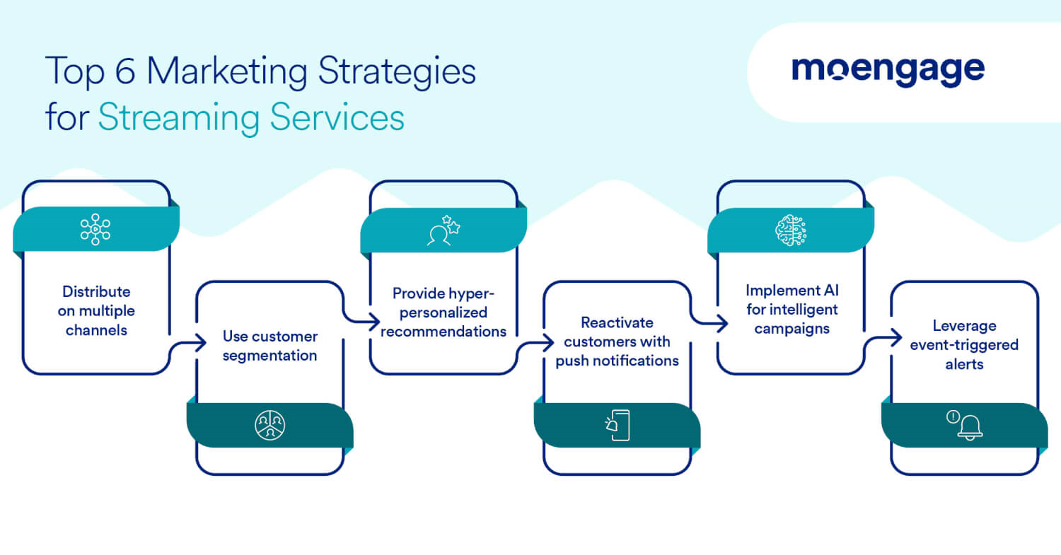
Objective
To improve user experience and business decisions on a streaming platform, analyze user behavior, preferences, and engagement by tracking metrics like time spent, content watched, and interactions, then identify trends and patterns to optimize content recommendations, platform features, and marketing strategies.

Slide 8
1. Subscription & Revenue Analysis
Monthly revenue based on different subscription plans.
To calculate monthly revenue from subscription plans, multiply the number of active subscribers for each plan by their respective monthly fee, then sum the results across all plans.
Monthly revenue = Monthly Price * Total Active User
= (7.99* 1000= ₹ 7,990.00)
Sum across all plans = ₹ 12,026,000.00

Slide 9
Distribution of users across different price tiers.
Tiered pricing involves dividing customers into groups based on factors like Favorite Genre as per Customer and assigning different Monthly prices to each group. This allows businesses to offer flexible pricing options and cater to diverse customer needs.
In this data set Tier 7.99 Drama with 59 points , in Tier 11.99 Horror with 56 points and in Tier 15.99 Comedy with 54 points. So, the most preferred tire is 11.99 where all genre are more or less equally watched by users.

Slide 10
2. User Engagement Metrics:
User engagement metrics are measurements that quantify how users interact with a product or service, helping businesses understand user behavior, preferences, and satisfaction levels.
Average watch hours per user.
In this the AVERAGE watch hours by per user is 500 hrs.

Slide 11
Total movies vs. series watched per user.
It varies greatly depending on individual preferences, time, and access to platforms. Some people may watch hundreds of movies and series per year, while others may watch much fewer.
Total watched Movies is 11859 and total web series watched is 2469 by per user.

Slide 12
Impact of recommended content on engagement.
Recommended content has a significant positive impact on engagement by providing users with personalized content that aligns with their interests, thereby increasing their time spent on a platform and encouraging them to interact more with the content.
In this data set the most recommended content on engagement per hour is favorite genre Sci-fi with 1980.

Slide 13
3. Demographic & Behavioral Insights
Preferred genres by age group.
Movie genres can be categorized by age group based on maturity level and preferred themes. Children generally enjoy animated films, family-friendly comedies, and adventure stories, while adolescents may prefer action, fantasy, and coming-of-age narratives. Adults often gravitate towards dramas, thrillers, and historical pieces, while older adults may lean towards classic films, documentaries, and biographical stories.
In this bar graph is shows that the most preferred genre by age group is Comedy up to 39 age group.

Slide 14
Device usage trends.
Device usage trends show a strong dominance of smartphones. People are spending considerable time on their devices, with smartphone use increasing in various categories like social media and entertainment.
First Device Used | Sum of Watch Hours
Desktop | 49473
Laptop | 41910
Smart TV | 53863
Smartphone | 56814
Tablet | 52456
Grand Total | 254516
In this chart and bar graph its shows that Smart Phone are the device which is in trends for usage of entertainment .

Slide 15
Peak watch time trends (Morning, Evening, Late Night).
In the television industry, peak viewing times generally occur during the evening, with a strong increase from 8-9 pm. However, this peak can shift slightly depending on the platform and the demographic. Overall, the trend shows a shift towards later viewing times, influenced by streaming services and different viewing habits
In this bar graph the Peak watch time trends is Late Night with 271 Hours.

Slide 16
4. Retention & Loyalty:
Membership status (Active vs. Inactive).
An active membership status signifies that a member is currently paying and has access to all the benefits and privileges associated with their membership level.
Membership status | Sum of Loyalty Points
Active | 2444217
Grand Total | 2444217
In this data set the Membership Status of all user are active. there is no such inactive user in this data set.

Slide 17
Loyalty points distribution.
Loyalty points are typically distributed to customers based on their engagement and purchases within a specific loyalty program. These points can be redeemed for various rewards like discounts, products, or services. Distribution methods can vary, including awarding points for purchases, promotional activities, or other actions that benefit the brand.
In this bar graph the loyalty points distribution according to the monthly price tiers is 07.99 group with 826831 loyalty points.

Slide 18
Frequency of logins and content downloads.
In the entertainment sector, login and content download frequencies vary significantly depending on the platform and content type. While some platforms like streaming services see high daily logins and content downloads for movies and TV shows, others, like online gaming or social media, may have different usage patterns. Data analytics plays a crucial role in understanding these patterns, allowing companies to optimize content creation, marketing, and distribution
Last Login | Count Downloaded Content
Nov | 421
Dec | 579
Grand Total | 1000
Max login is done in the month of Dec with downloaded content of 579 times.

Slide 19
5. Payment Preferences & Regional Trends:
Preferred payment methods by region
Preferred payment methods vary significantly by region, influenced by factors like digital infrastructure, consumer behavior, and local payment options. In general, credit and debit cards are widely used globally, while digital wallets and mobile payments are gaining popularity, particularly in Asia
In this bar graph the most preferred payment methods is PAYPAL with 48 % in UK Region.

Slide 20
Subscription trends by country
In the entertainment industry, subscription trends vary significantly by country. While the United States is a large market for filmed entertainment.
In this bar graph the trends is in USA with 1890.42 subscription

Slide 21
Language preferences and their correlation with engagement.
In this data set the most preferred language with the correlation with engagement is French with 46762.

Slide 22
In summary, the "Streaming Service User Analysis" project effectively utilized Microsoft Excel to dissect and understand user behaviors and engagement patterns within a streaming platform. By examining a comprehensive dataset encompassing user demographics, activity metrics, content preferences, and device usage, the analysis unveiled critical insights into how users interact with the service. These findings not only highlight prevailing consumption trends but also offer actionable intelligence to enhance user experience, personalize content delivery, and inform strategic business decisions. Moving forward, leveraging these insights can drive targeted improvements, fostering increased user satisfaction and loyalty in an increasingly competitive streaming landscape.​
Conclusion

Slide 23
Thank you

